Slide 1
California State University, Sacramento Computer Science Department
CSC 179 : Software Testing and Quality Assurance
Summer 2022
Lecture # 7
White Box Testing
Path Testing

Slide 2

Software Testing – The Challenge
Testing can only show the presence of failures…
…not their absence

Slide 3
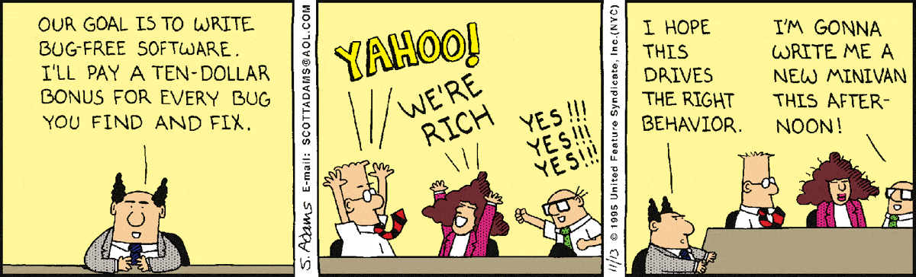
Driving Testing Behavior

Slide 4
Testing Levels
main()
class A
class B
method mA1()
method mB1()
method mA2()
method mB2()

Slide 5
Testing Levels
main()
class A
class B
method mA1()
method mB1()
method mB1()
method mA2()
method mB2()
method mB2()
Unit testing: test each unit (method) individually

Slide 6
Testing Levels
main()
class A
class B
method mA1()
method mB1()
method mB1()
Module testing: test each class, file, module, component
method mA2()
method mB2()
method mB2()
Unit testing: test each unit (method) individually

Slide 7
Testing Levels
main()
class A
class B
Integration testing: test how modules interact
method mA1()
method mB1()
method mB1()
Module testing: test each class, file, module, component
method mA2()
method mB2()
method mB2()
Unit testing: test each unit (method) individually

Slide 8
Testing Levels
main()
System testing: test the overall functionality of the system
class A
class B
Integration testing: test how modules interact
method mA1()
method mB1()
Module testing: test each class, file, module, component
method mA2()
method mB2()
Unit testing: test each unit (method) individually

Slide 9
Testing Levels
Acceptance testing: is the software acceptable to the user?
main()
System testing: test the overall functionality of the system
class A
class B
Integration testing: test how modules interact
method mA1()
method mB1()
Module testing: test each class, file, module, component
method mA2()
method mB2()
Unit testing: test each unit (method) individually

Slide 10
V Model of System Development
Requirements
Acceptance Test
Architectural Design
System Test
Subsystem Design
Integration Test
System Development
System Verification
Detailed Design
Module Test
Implementation
Unit Test

Slide 11
Path Testing
Path testing is a structural testing method
It uses the source code to find every possible executable path.
It enable testers to find faults within the source code.
It designed to execute all or selected path with segment of code.
11

Slide 12
Path Testing
It is the primary unit test technique
Preferred by software development and test engineers
Proven to be highly effective in identifying the independent paths and the hidden coding defects and issues in a source code.
Its objectives to eliminate testing redundancy and accuracy in finding hidden coding defects make it so simple yet inventive.
12

Slide 13
Basis Path Testing
However, the software under test includes many entry and exit points.
Testing each of these points is very challenging and time-consuming.
To reduce redundancy (reduce the redundant test cases) and achieve maximum test coverage, basis path testing is used.
13

Slide 14
Basis Path Testing
It is a White Box Testing method in which test cases are defined based on flows or logical paths that can be taken through the program.
Objectives:
Enables the test case designer to derive a logical complexity measure of the design
To define the number of independent paths and to maximize test coverage.
14

Slide 15
Basis Path Testing Steps
1. Create /draw a control flow graph (to determine different program paths)
2. Calculate Cyclomatic complexity (metrics to determine the number of independent paths)
3. Find a basis set of paths
4. Generate test cases to exercise each path
15

Slide 16
Create Control Flow Graph Flow Graph
1 int functionY(void)
2 {
3 int x = 0;
4 int y = 19;
5 A: x++;
6 if (x > 999)
7 goto D;
8 if (x % 11 == 0)
9 goto B;
10 else goto A;
11 B: if (x % y == 0)
12 goto C;
13 else goto A;
14 C: printf("%d\n", x);
15 goto A;
16 D: printf("End of list\n");
17 return 0;
18 }
3
4
5
6
8
7
10
9
16
11
17
13
12
14
15

Slide 17
Create Control Flow Graph
Arrows called edges indicates flow of control.
Circles called nodes indicates one or more actions.
Areas bounded by edges and nodes are called regions.
A predicate node is a node containing a condition.
17

Slide 18
Flow Graph Notations
A circle in a graph represents a node, which stands for a sequence of one or more procedural statements
A node containing a simple conditional expression is referred to as a predicate node
Each compound condition in a conditional expression containing one or more Boolean operators (e.g., and, or) is represented by a separate predicate node
A predicate node has two edges leading out from it (True and False)

Slide 19
Flow Graph Notation
An edge, or a link, is an arrow representing flow of control in a specific direction
An edge must start and terminate at a node
An edge does not intersect or cross over another edge
Areas bounded by a set of edges and nodes are called regions
When counting regions, include the area outside the graph as a region, too
19

Slide 20
Cyclomatic Complexity
Software engineers and test engineers always aim for code that is easy to test, easy to understand and modify. (testable code)
The question always “ How do we know that the code is testable
One answer is that make it short as short code is always good.
But that might not be sufficient – we need a better metric
Cyclomatic complexity is a valuable metric to measure the complexity of code. It is computed using the control flow graph of the code.
20

Slide 21
Cyclomatic Complexity
Quantitative software metric to determine the number of independent paths as well as the complexity of the program.
It is also a source code complexity unit that is corresponded to diverse coding errors.
It is computed by generating a control-flow graph of the codes measuring the linearly independent paths.
21

Slide 22
Cyclomatic Complexity
Provides a quantitative measure of the logical complexity of a program
Defines the number of independent paths in the basis set
Provides an upper bound for the number of tests that must be conducted to ensure all statements have been executed at least once

Slide 23
Cyclomatic Complexity
Can be computed three ways
The number of regions
= E – N + 2, where E is the number of edges and N is the number of nodes in graph G
= P + 1, where P is the number of predicate nodes in the flow graph G
23

Slide 24
Deriving the Paths and Test Cases
Using the design or code as a foundation, draw a corresponding flow graph
Determine the cyclomatic complexity of the resultant flow graph
Determine the independent paths
Prepare test cases that will force execution of each path in the basis set

Slide 25
FLOW GRAPH EXAMPLE

Slide 26
1 int functionY(void)
2 {
3 int x = 0;
4 int y = 19;
5 A: x++;
6 if (x > 999)
7 goto D;
8 if (x % 11 == 0)
9 goto B;
10 else goto A;
11 B: if (x % y == 0)
12 goto C;
13 else goto A;
14 C: printf("%d\n", x);
15 goto A;
16 D: printf("End of list\n");
17 return 0;
18 }
3
4
5
6
8
7
10
9
16
11
17
13
12
14
15

Slide 27
A Sample Function to Diagram and Analyze

Slide 28
1 int functionZ(int y)
2 {
3 int x = 0;
4 while (x <= (y * y))
5 {
6 if ((x % 11 == 0) &&
7 (x % y == 0))
8 {
9 printf(“%d”, x);
10 x++;
11 } // End if
12 else if ((x % 7 == 0) ||
13 (x % y == 1))
14 {
15 printf(“%d”, y);
16 x = x + 2;
} // End else
18 printf(“\n”);
19 } // End while
20 printf("End of list\n");
21 return 0;
22 } // End functionZ
3
4
6
7
9
12
13
10
15
16
18
20
21

Slide 29
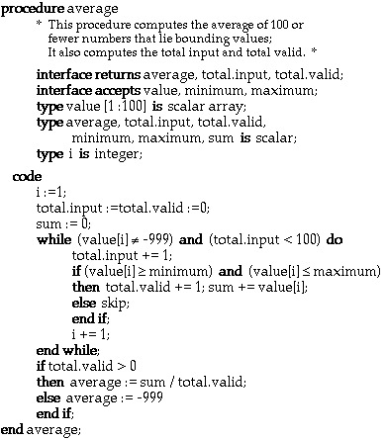
Deriving Test Cases: An Example
29

Slide 30
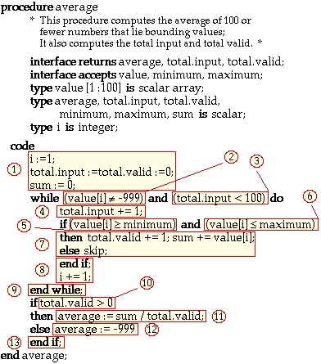
Deriving Test Cases: Identify Flow
30

Slide 31
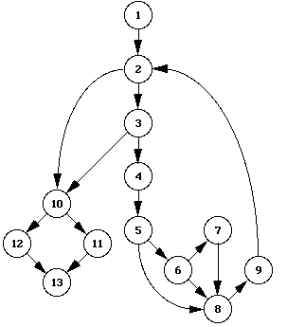
Deriving Test Cases: Draw Flow Graph
31

Slide 32
Deriving Test Cases: Determine Cyclomatic Complexity
=> V(G) = 6
17 edges - 13 nodes + 2 = 6
5 predicate nodes + 1 = 6
32

Slide 33
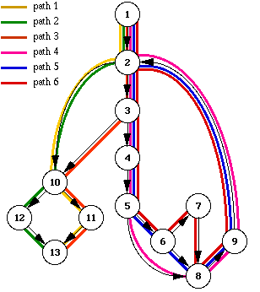
Deriving Test Cases: Determine A set of Linearly Independent Paths
33

Slide 34
Deriving Test Cases: Determine A set of independent Paths
path 1: 1 - 2 - 10 - 11 - 13
path 2: 1 - 2 - 10 - 12 - 13
path 3: 1 - 2 - 3 - 10 - 11 - 13
path 4: 1 - 2 - 3 - 4 - 5 - 8 - 9 - 2 - ...
path 5: 1 - 2 - 3 - 4 - 5 - 6 - 8 - 9 - 2 - ...
path 6: 1 - 2 - 3 - 4 - 5 - 6 - 7 - 8 - 9 - 2 - ...
34

Slide 35
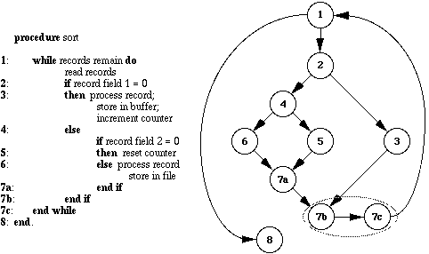
Another Example ….
35

Slide 36
Cyclomatic Complexity
E-N+2 = 4
Four paths to test …
1,8
1,2,3,7b,1,8
1,2,4,5,7a,7b,1,8
1,2,4,6,7a,7b,1,8
36

Slide 37
Example – Create the Model
Software Artifact
/**
* Return index of node n at the
* first position it appears,
* -1 if it is not present
*/
public int indexOf (Object o)
{
for (int i=0; i < list.size(); i++)
if (list.get(i).equals(o))
return i;
return -1;
}
Control Flow Graph
1
i=0
2
i<list.size()
return -1
3
4
if (…)
return i
5
6
i++

Slide 38
Example – Create the Model
Control Flow Graph
Initial Node: 1
Final Nodes: 3, 5
Edges:
(1, 2)
(2, 3)
(2, 4)
(4, 5)
(4, 6)
(6, 2)
1
i=0
2
i<list.size()
return -1
3
4
if (…)
return i
5
6
i++
Support tool for graph coverage:
http://www.cs.gmu.edu/~offutt/softwaretest

Slide 39
Example – Test Reqs and Specs
Control Flow Graph
Six requirements for edge coverage:
(1, 2)
(2, 3)
(2, 4)
(4, 5)
(4, 6)
(6, 2)
Test paths:
[1, 2, 3]
[1, 2, 4, 6, 2, 4, 5]
1
i=0
2
i<list.size()
return -1
3
4
if (…)
return i
5
6
i++
Next we need to find values to execute those test paths

Slide 40
Example – Input Values
Control Flow Graph
Test path [1, 2, 3]
list = { }
o = null
Test path [1, 2, 4, 6, 2, 4, 5]
list = { 1, 2 }
o = 2
1
i=0
2
i<list.size()
return -1
3
4
if (…)
return i
5
6
i++
We’ll talk about test implementation in future classes

Slide 41
Tools - Static Analysis
Unified Code Counter (UCC) produced by the Center for Systems and Software Engineering at the University of Southern California, are freely available.
Commercial tools such as Scientific Toolworks’ Understand, can also be used …
41

Slide 42
Tools - Static Analysis
Atlasean’s Bambo measure and display cyclomatic complexity for utilization by software developers, testers, and quality assurance analysts.
42

Slide 43
Tools - Static Analysis
OCLint – Static code analyzer for C
Reflector Add In – Code metrics for .NET
GMetrics – Find metrics in Java related applications
43

Slide 44
Benefits of Basis Path Testing
For both software developers and testers
Provides better and greater coverage
Validates other white-box tests – often used to validate and affirms the other white box testing methods
44

Slide 45
Benefits of Basis Path Testing
Reduces test redundancy – it aims to minimize the number of redundant tests.
Tests the logic – It tests the logic of the program along with corroborating the other white-box tests.
Uncovers hidden defects –has been proven to be highly effective in identifying hidden defects
45

Slide 46
Benefits of Basis Path Testing
Supports integration testing:
When one unit is integrated with another unit, the likelihood of more defects increases dramatically, Basis path testing minimizes this risk and enable safter integration.
46

Slide 47
Benefits of Basis Path Testing
Minimalize testing effort
This testing automatically takes the software complexity into account while calculating the cyclomatic complex.
As the testing effort directly proportional to the program’s complexity.
47

Slide 48
Benefits of Basis Path Testing
Provides a systematic method/way of designing test cases
Studies show that path testing catches 50% of all defects caught during unit testing.
About 33% of all bugs.
48

Slide 49
Limitations of Basis Path Testing
Interface mismatches and mistakes are not easily found.
Not all initialization errors are caught by path testing.
Specification errors and mistakes are not discovered/found
49

Slide 50
Test Case Characteristics
Test case has high probability of finding a defect
Test case is not redundant
Test case should have high likelihood of uncovering a whole class of defects
Test case should not be trivial (superficial) but also not too complex
50

Slide 51
Test Case Characteristics
Test case should be concise and complete
Test case should be traceable: can be traced to requirements.
Test case should be repeatable - used to perform the test again in the same project
Test case should be reusable - can execute the same test case a number of times in different project(s).
51

